Slide 1
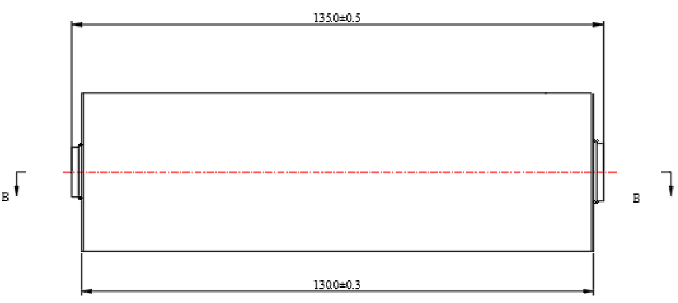
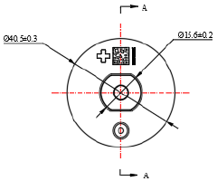
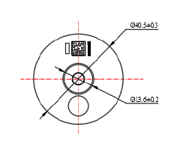
Lithium Iron Phosphate Cell
EVE C40
Specifications
Item | Standards | Remarks
Nominal Capacity | 20.5Ah | 0.33C, 25±2ºC, 2.5~3.65V
Nominal Energy | 19.5Ah | 0.33C, 25±2ºC, 2.5~3.65V
Initial IR | ≤2mΩ | AC, 1kHz, 30% SOC
Nominal Voltage | 3.25V
Weight | 374g | Max
Charging Cut-off Voltage | 3.65V
Discharging Cut-off Voltage | 2.5V (T>0ºC) 2.0V (T≤0ºC)
Max Cont. Charging Current | 20A | 1C
Max Cont. Discharging Current | 60A | 3C
Cycling Performance | 4000 cycles (25ºC) 1500 cycles (45ºC)
Operation Temperature | Charging (0~50ºC) Discharging (-20~60ºC)
Storage Temperature | 3 month (0~45ºC) 1 month (-20~45ºC)
Dimensions (mm)
Copyright © 2015 EVE Energy Company . All Rights Reserved.
For more details, please contact: EVE Energy North America, 46 Village Pointe Dr, Powell, Ohio, 43065
Email: info@evebatteryusa.com Phone: 614.389.2552

